Slide 1
#3 How to create a basic Bluetooth® Low Energy peripheral in 10 min Click & Go

Slide 2

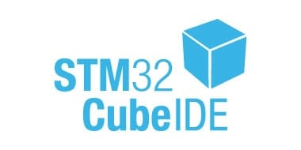
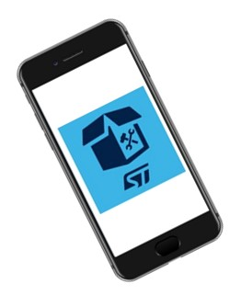
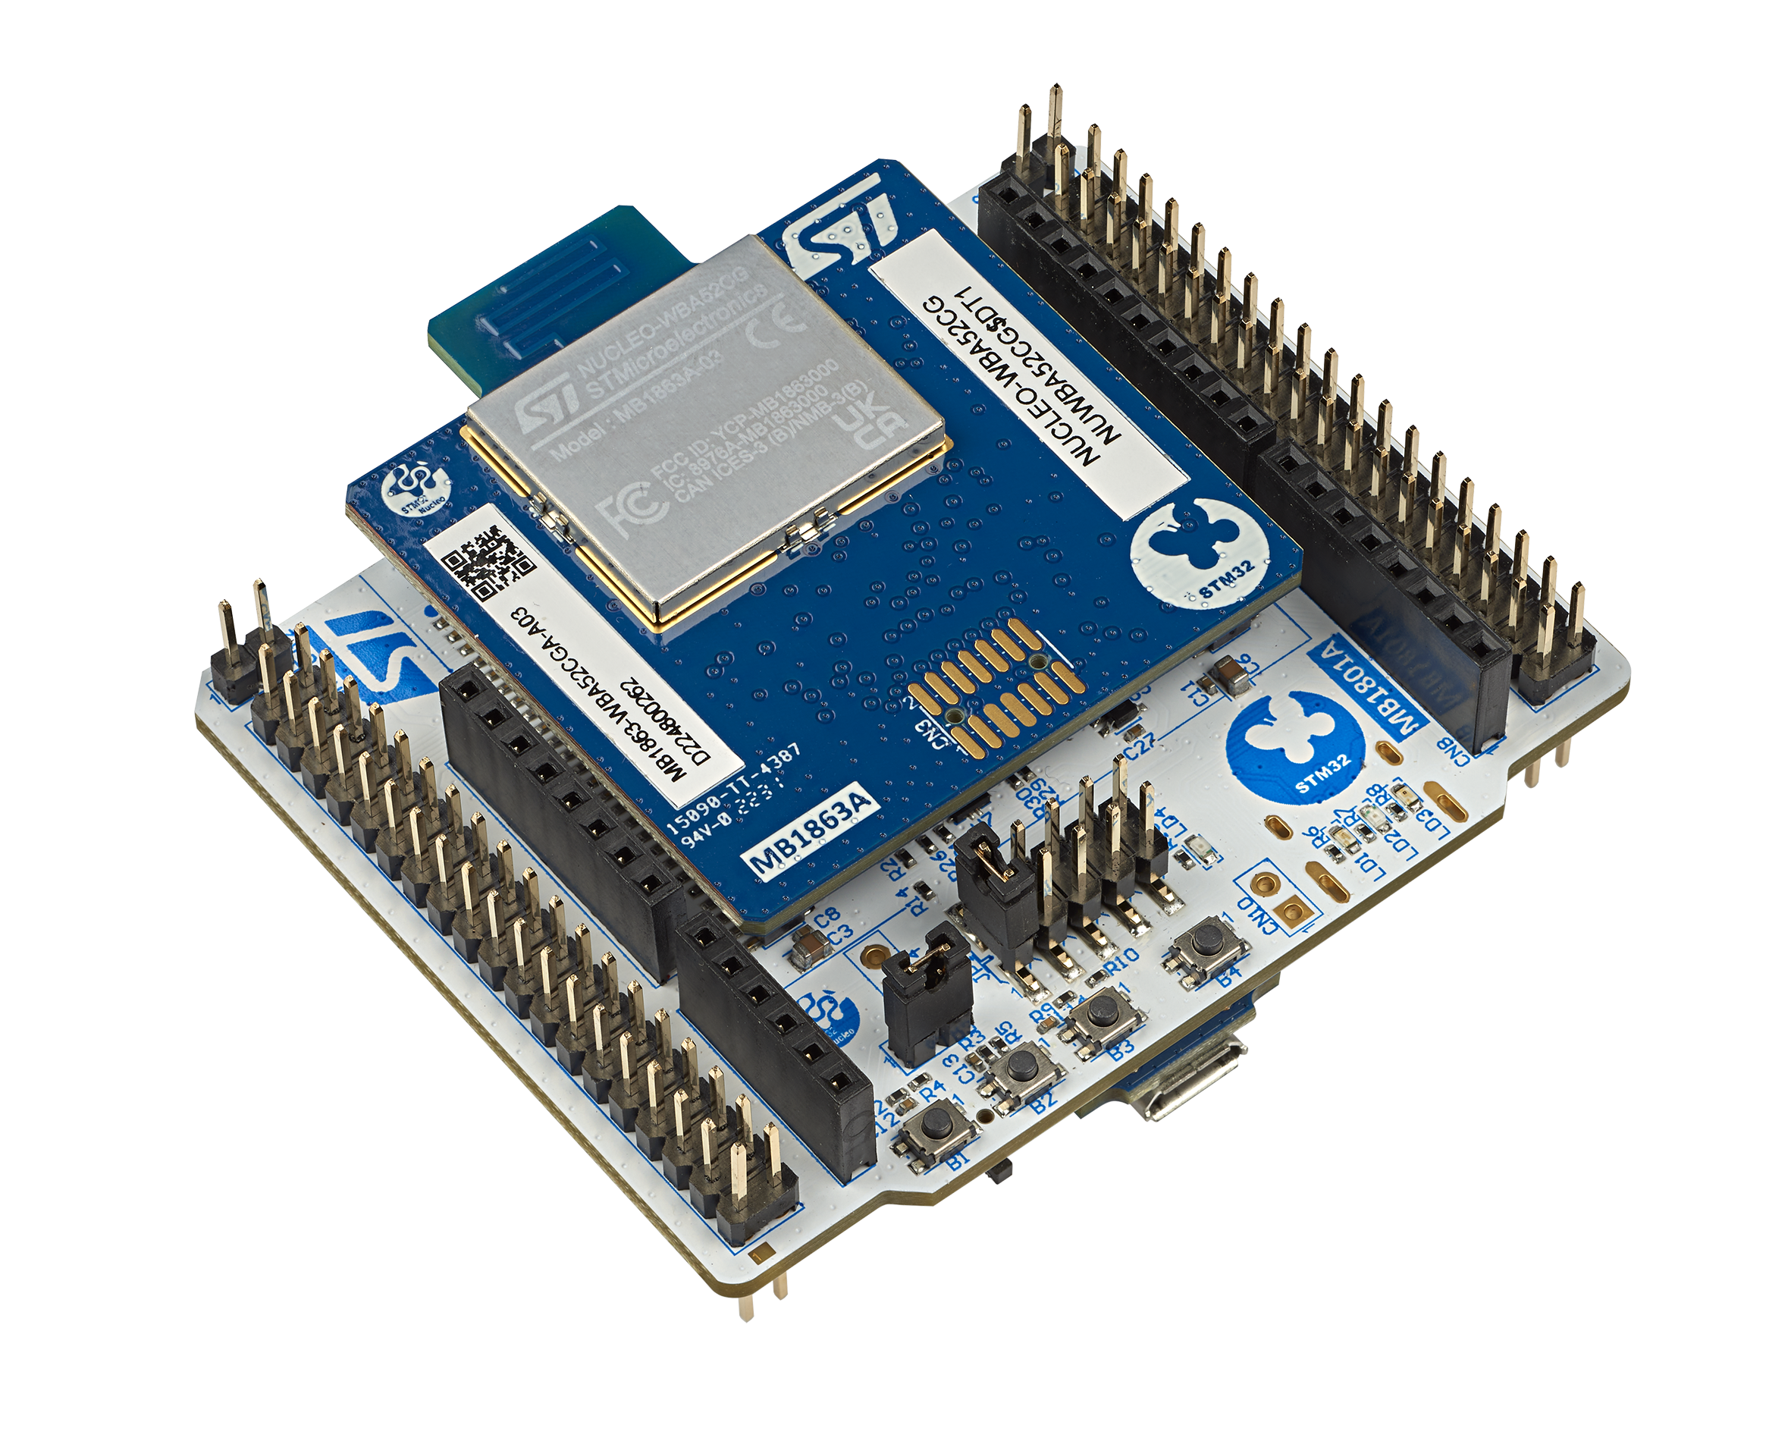
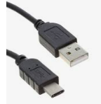

Prerequisites Refresh
SW prerequisites
STM32CubeWBA MCU package (v1.2.0 as basis + optional patch)
IDE: STM32CubeIDE (1.14.0)
A serial terminal (e.g. TeraTerm)
ST BLE ToolBox Smartphone application
NUCLEO-WBA52
USB C cable
NUCLEO STM32WBA55
HW prerequisites
ST BLE Toolbox

Slide 3
Basic Peripheral in 10mn : Click & Go :

Slide 4

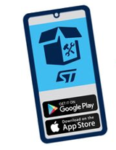
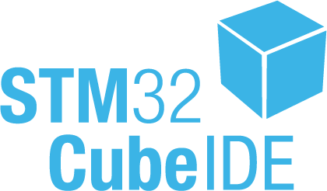
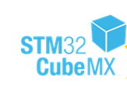



Purpose
As a first exercise, Let’s start from an existing project example BLE_P2PServer
Purpose of this session is to modify this code example to customize advertising data (Local name).
In the second part of the Hands on we will generate associated code, flash and test over Nucleo-WBA5x board
BLE_P2PServer Application
+
STM32WBA55
BLE_P2PServer

Slide 5


What is a P2P Server?
P2P is a Generic Attribute Profile (GATT) based on Bluetooth® Low Energy defined by STM with proprietary UUIDs 128bit
ST BLE Toolbox
GATT Client
GAP central
GATT Server
GAP peripheral
Notes:
What are we going to do?
Create device that can report values to mobile phone and accept commands from it
Example use cases: Thermostat, or any other home appliance with some sensor and some actuator
How are we going to do that? We will start from empty CubeMX project and add all peripherilas that BLE Middleware rely on. Then we will add some application code for sending and receiving data.

Slide 6
What is a P2P Server?
P2P is widely used for direct connection and defined connection between GATT Server and GATT Client
Notification - SWITCH
Write - LED
ST BLE Toolbox
GATT Client
GAP central
GATT Server
GAP peripheral
Notes:
What are we going to do?
Create device that can report values to mobile phone and accept commands from it
Example use cases: Thermostat, or any other home appliance with some sensor and some actuator
How are we going to do that? We will start from empty CubeMX project and add all peripherilas that BLE Middleware rely on. Then we will add some application code for sending and receiving data.

Slide 7
STM32Cube capabilities
+
STM32Cube allow to start design within 3 options
1
Example application
complete application running over NUCLEO
2
Board level
all the hardware is already configured (NUCLEO_WBA55)
3
Chipset level
require to configure your HW (PCB) & your application
7

Slide 8
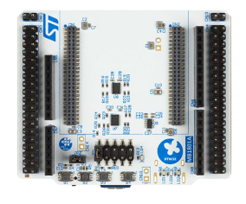
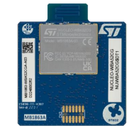

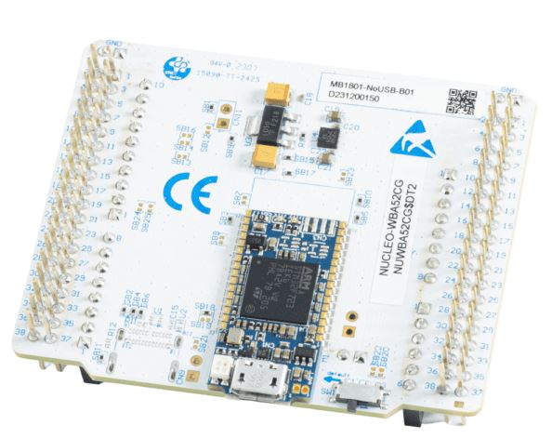

Connect the NUCLEO-WBA55CG to the PC
+
STM32WBA55CG
3 user LEDs
3 user buttons
STLINK-V3MODS
Programming
Debugging
VCOM

Slide 9
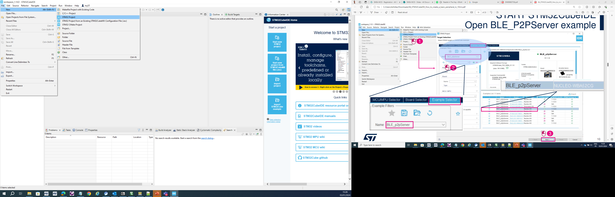
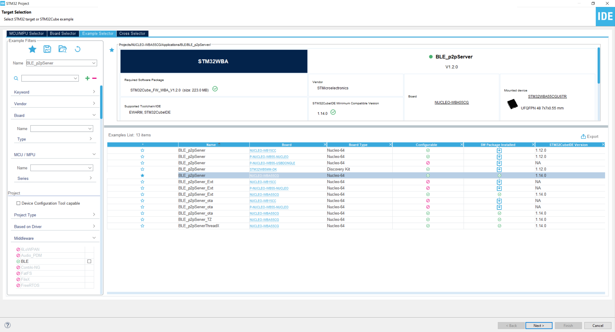

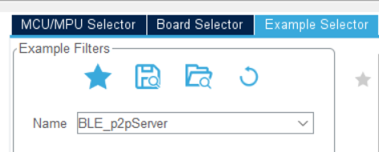
START STM32CubeIDE Open BLE_P2PServer example
1
2
3

Slide 10
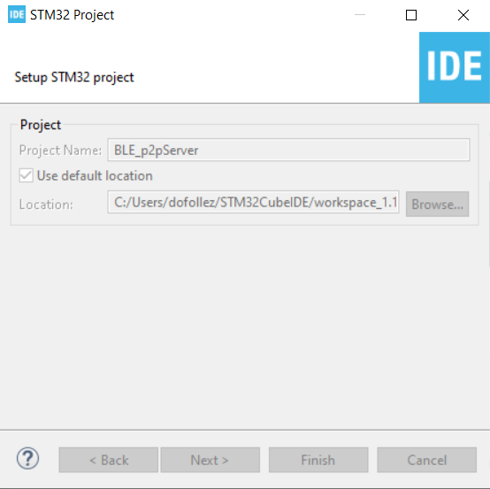
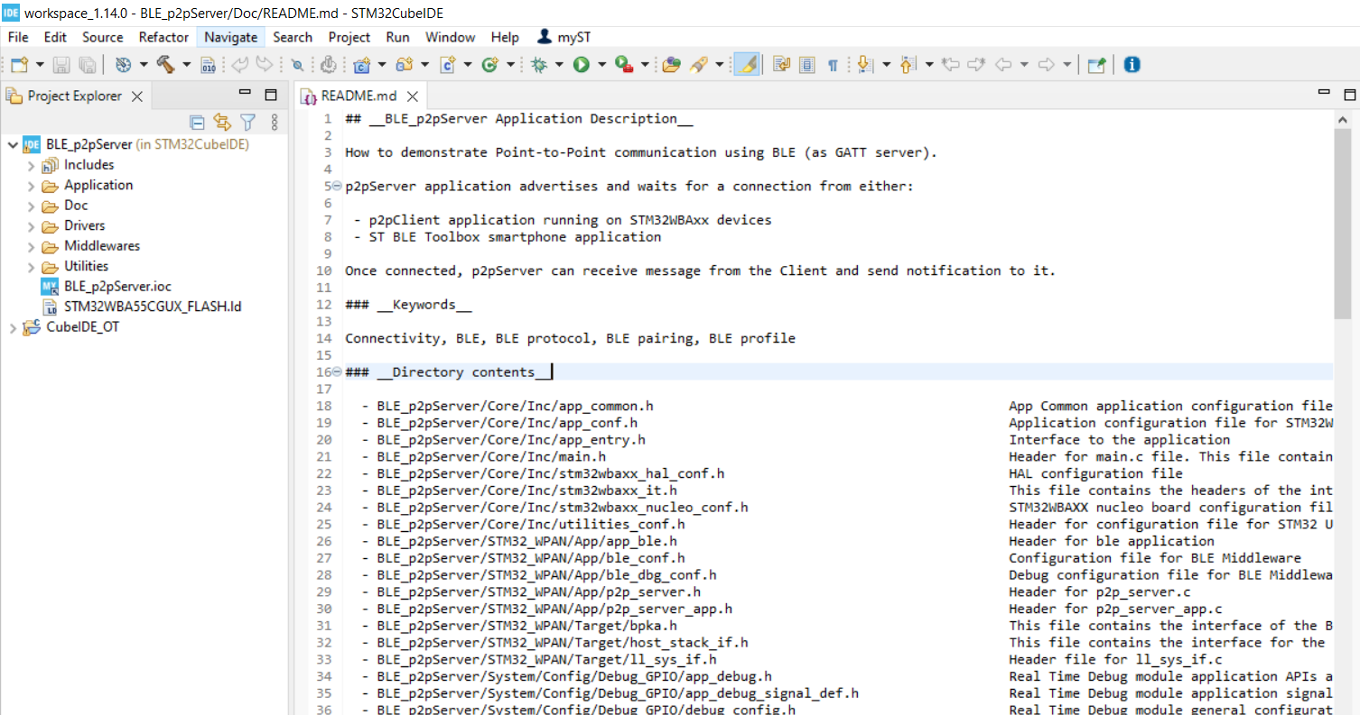
START STM32CubeIDE Open BLE_P2PServer example
1
At this stage, Default BLE_P2PServer project source code is ready to be modified, built and flash using STM32CubeIDE

Slide 11
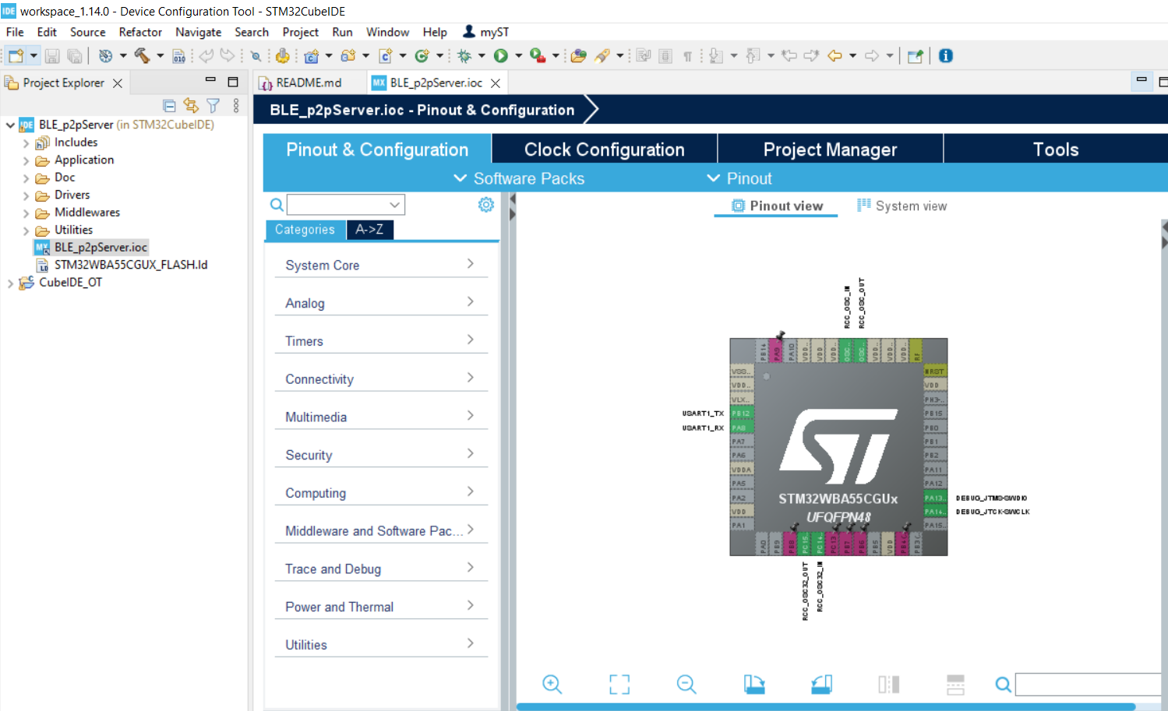
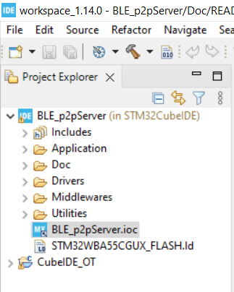
Let’s customize this BLE_p2pServer
1
Double click on .ioc file to Open CubeMx graphical interface

Slide 12
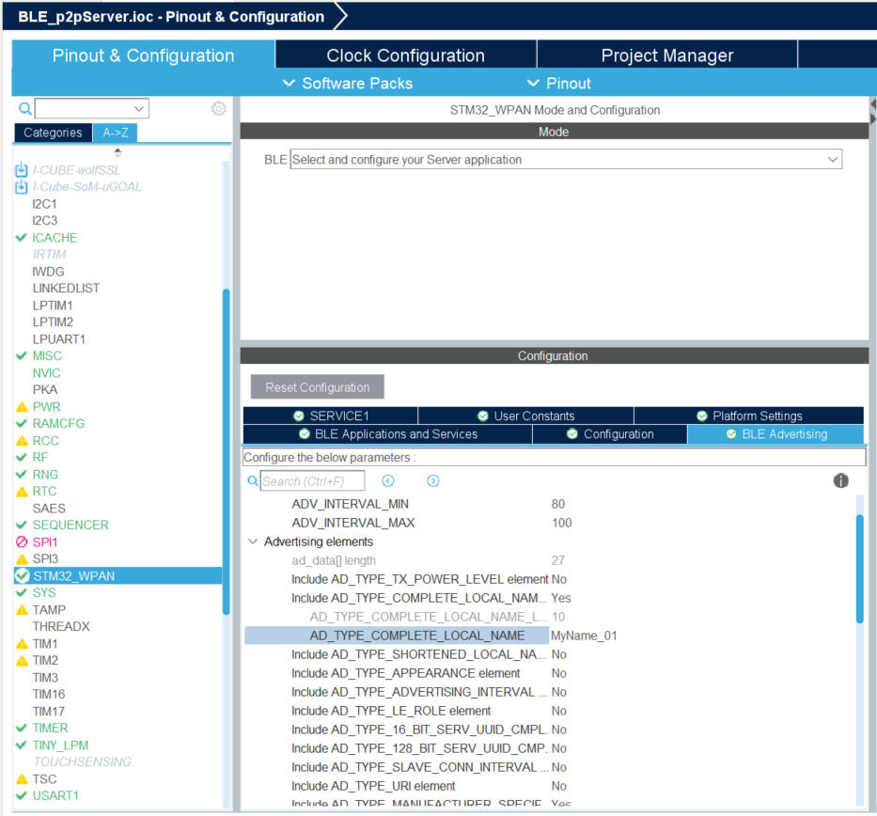

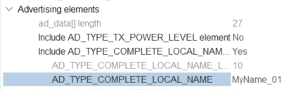
Customize Local Name
1
3
Local Name must be < 11
CubeMx contraints
2
4

Slide 13
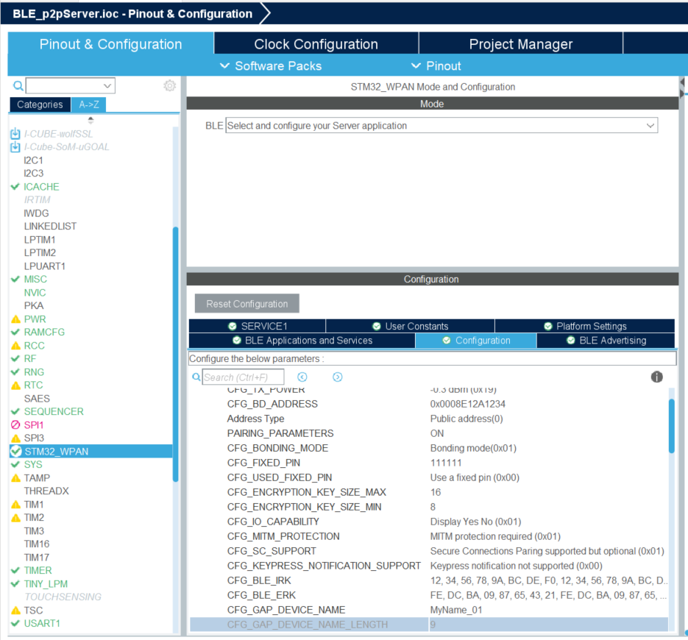
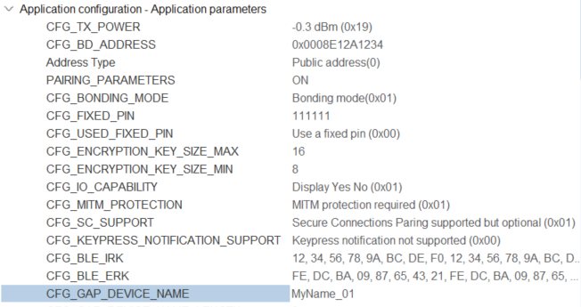
Customize Device Name
1
3
2
4
set same Device name =
Local Name
iOS displays Local Name (advertising data) prior to a 1st connexion.
After a 1st connexion iOS displays Device name (thanks to look up table : associates BLE MAC @ & Device Name)

Slide 14
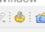
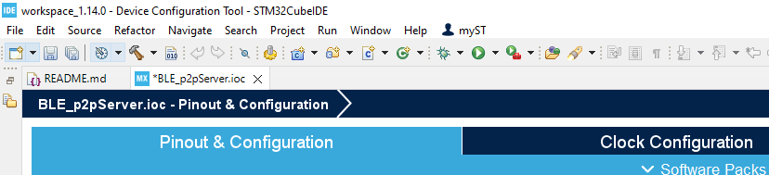
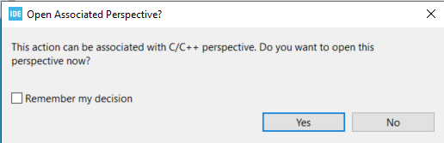
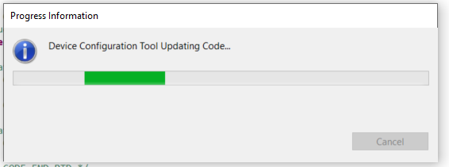
Code Generation
1

Slide 15
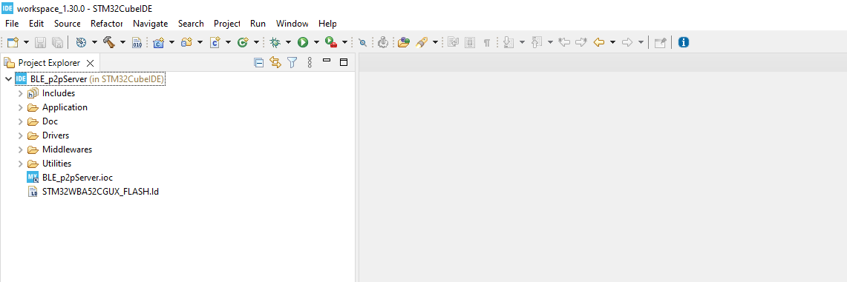
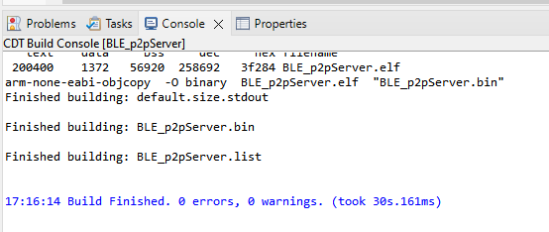
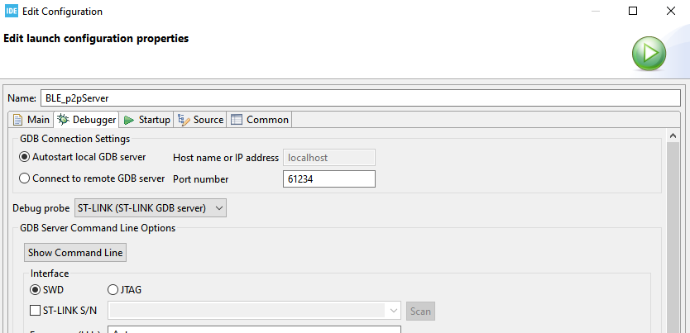
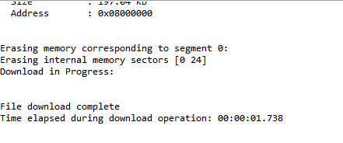
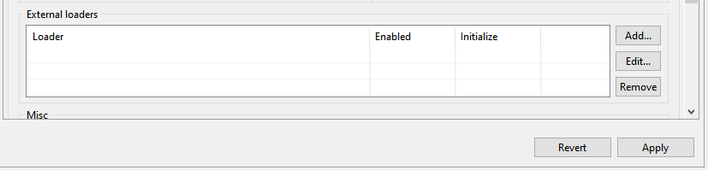
Build and flash modified project
1
Build
Plug the board
Flash
2
3

Slide 16
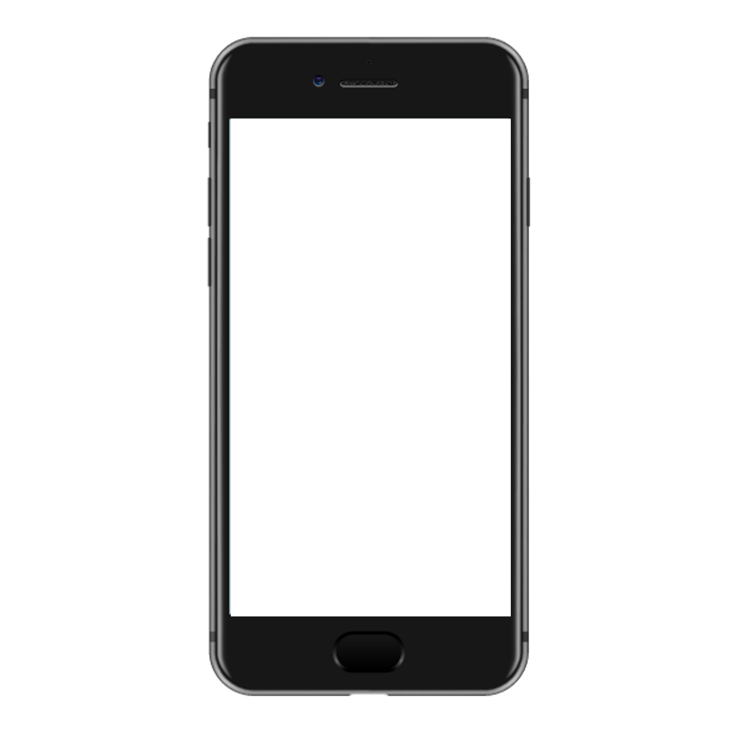

Enjoy your first STM32WBA55 project running!
ST BLE Toolbox

Slide 17
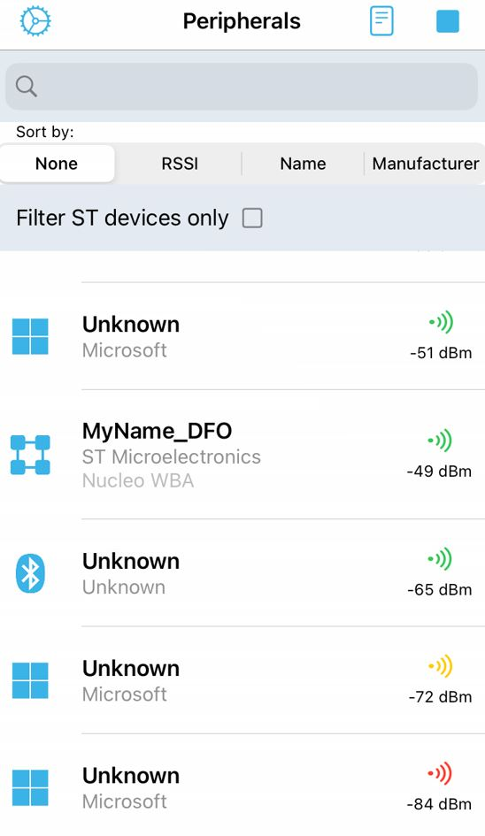
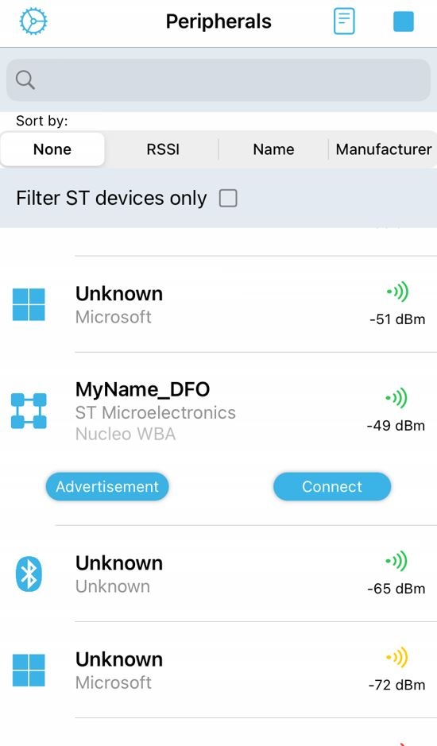
STBLE Toolbox
1
2
click on device
click on connect

Slide 18
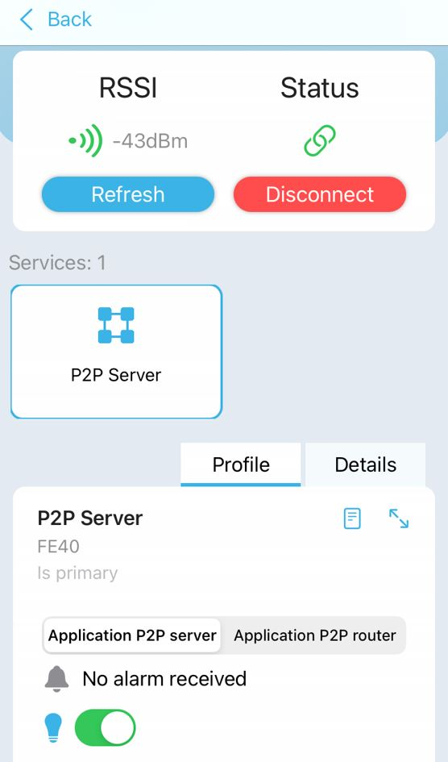
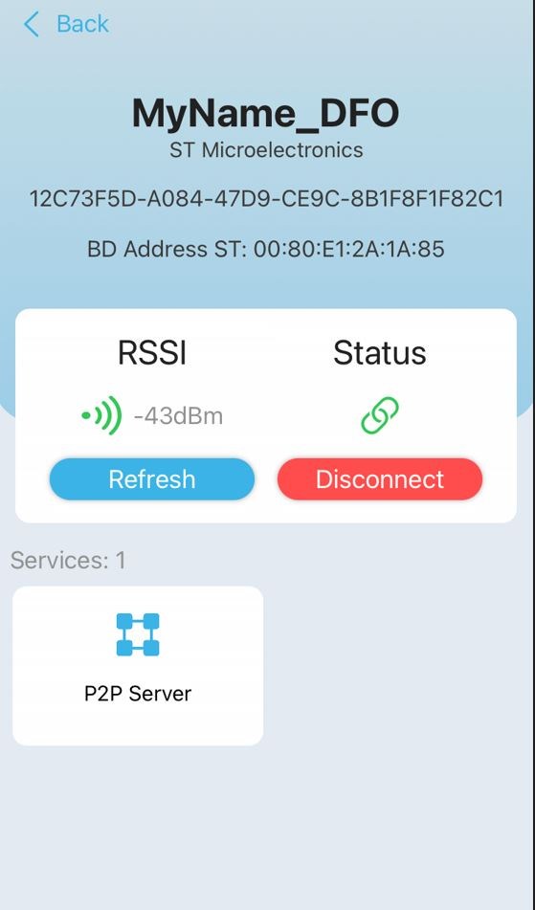
STBLE Toolbox
3
4
access to profile
control LED status on Nucleo

Slide 19
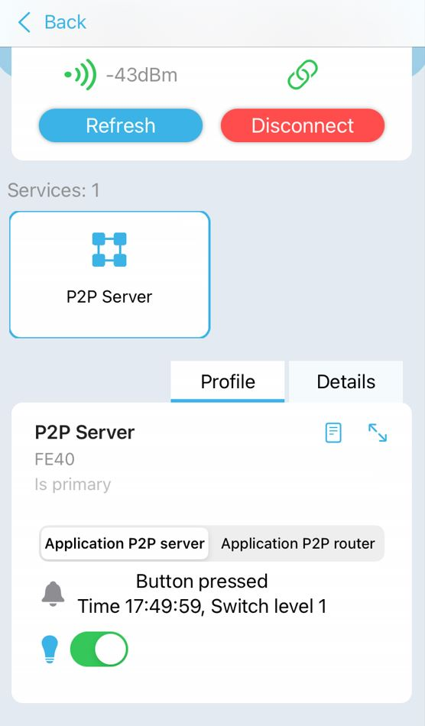
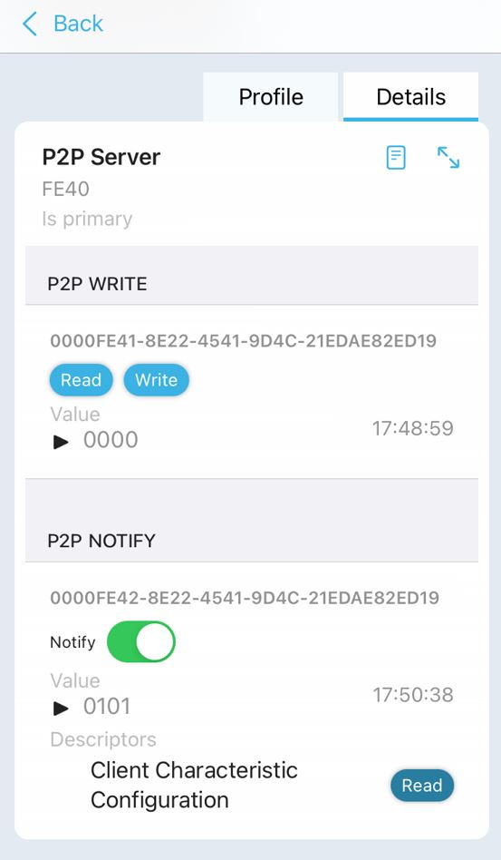
STBLE Toolbox
5
6
push button 1 and notify device
click on details to see bytes sent/received

Slide 20
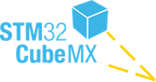
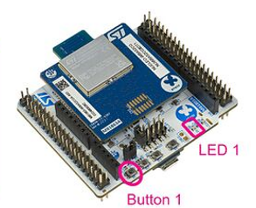
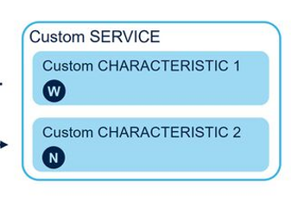
What’s next ?
completed
start and build from turn-key server application
Control LED
start from chipset, initialize and configure BLE server application
Send alert
client
Server
#1
initialize your HW
#2
configure & understand BLE settings (Adv, service, characteristic)
#2
modify application code & build

Slide 21


You can personalize this
last page with a short link
(ex. www.st.com/shortlink)
You can find a complete list of st.com short links on this page:
http://seo.st.com/toolbox/shortcuts/
Find out more at www.st.com

Slide 22

Please remove this page
before publishing the
presentation
For further support in creating a PowerPoint presentation, including graphic assets, formatting tools and additional information on the ST brand
you can visit the ST Brand Portal https://brandportal.st.com

